Slide 1
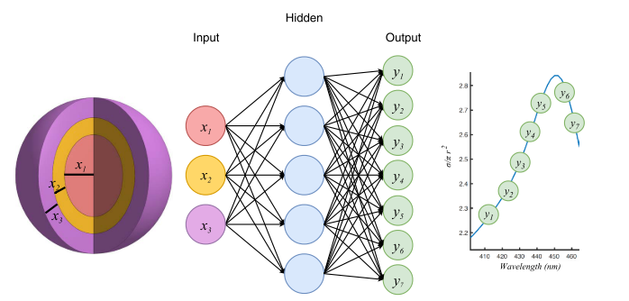
Last Week
This Week
Nanophotonic particle Inverse Design
DBR Inverse Design without Neural Network

Slide 2
Inverse Design with Neural Network
Basic Inverse Design
Structure
Transfer Matrix
Reflectivity
Inverse Design
Structure
Neural Network
Reflectivity
Inverse Design
NN Inverse Design
Inverse Design iteration: 50,000
Transfer Matrix: 0.1x50,000 = 5000 s = 83 min
Neural Network: 40 s

Slide 3
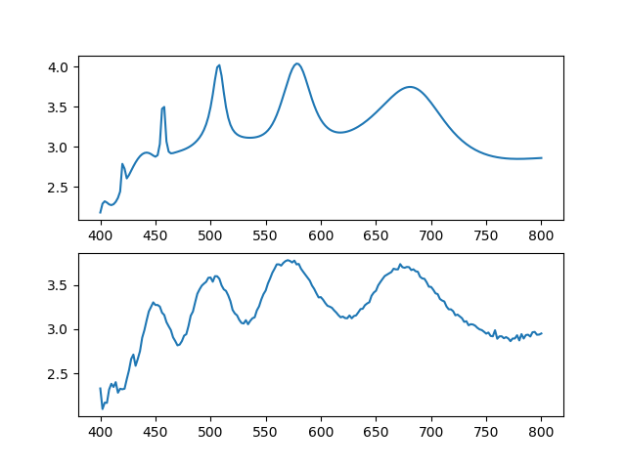
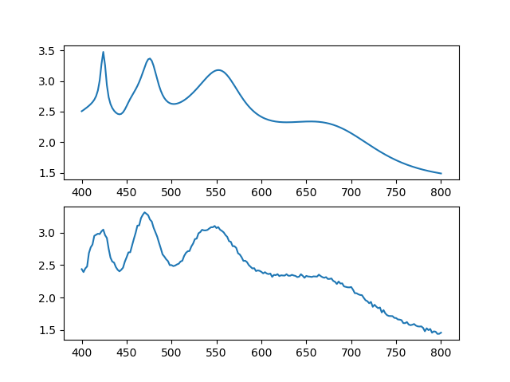
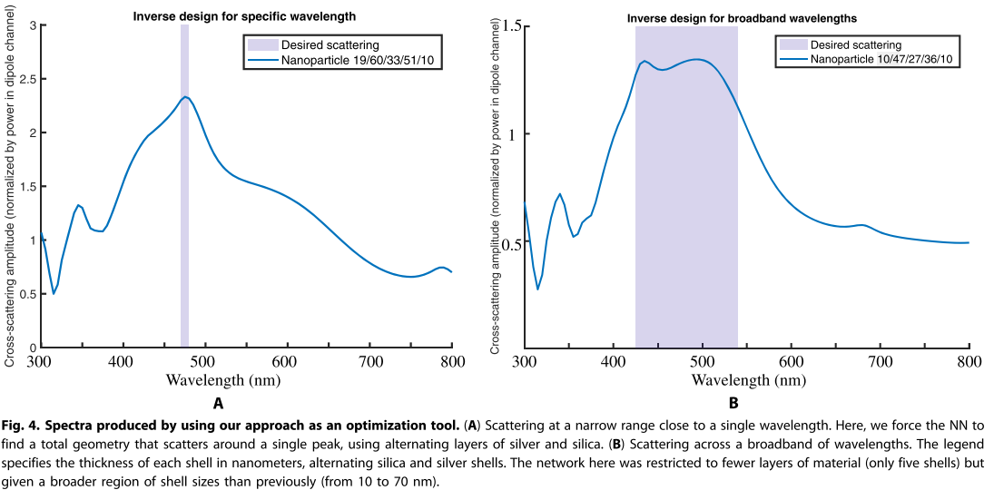
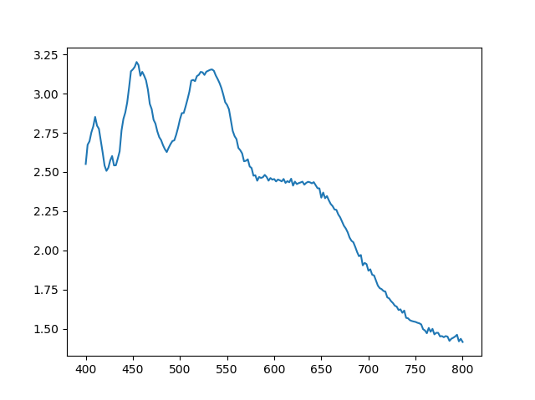
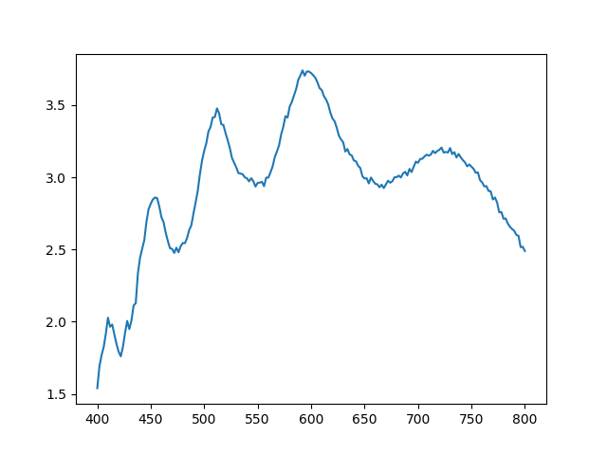
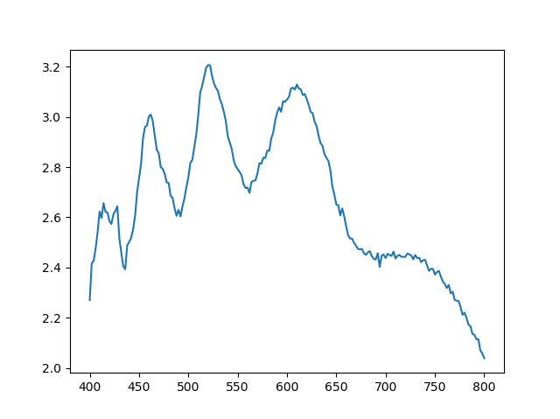
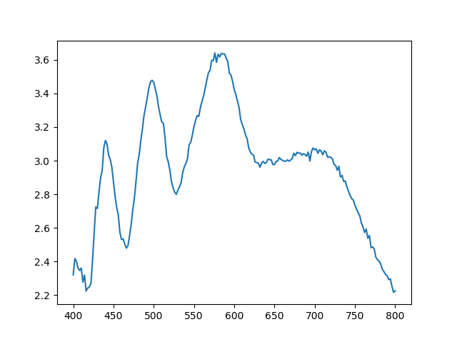
Neural Network (NN)
2018-Science Advances-4-Nanophotonic particle simulation and inverse design using artificial neural networks (John Peurifoy, Yichen Shen, Li Jing, Yi Yang, Fidel Cano-Renteria, Brendan G. DeLacy, John D. Joannopoulos, Max Tegmark, Marin Soljačić)
Test 1
Test 2
Numeric calculated
Numeric calculated
Scattering cross-section
Scattering cross-section
NN calculated
MSE = 0.0248
NN calculated
MSE = 9.56E-3
wavelength
wavelength
Scattering cross-section
Scattering cross-section
wavelength
wavelength
Test sets’ average Mean-Squared Error(MSE) = 0.011
Training data는 30 ~ 70 nm, 논문 design data는 10 ~ 70 nm 사용

Slide 4
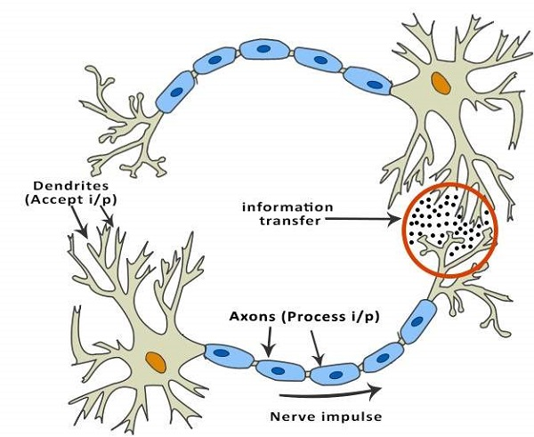
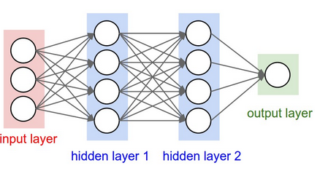
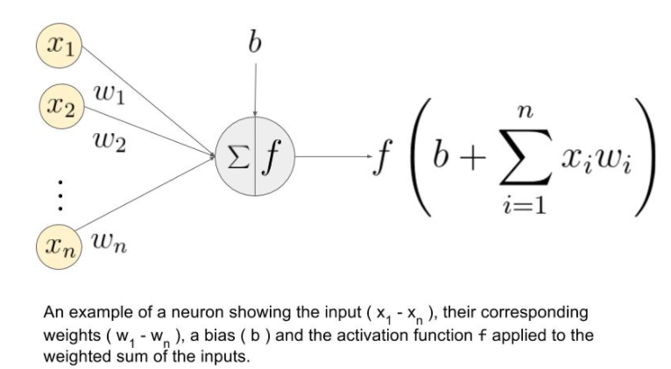
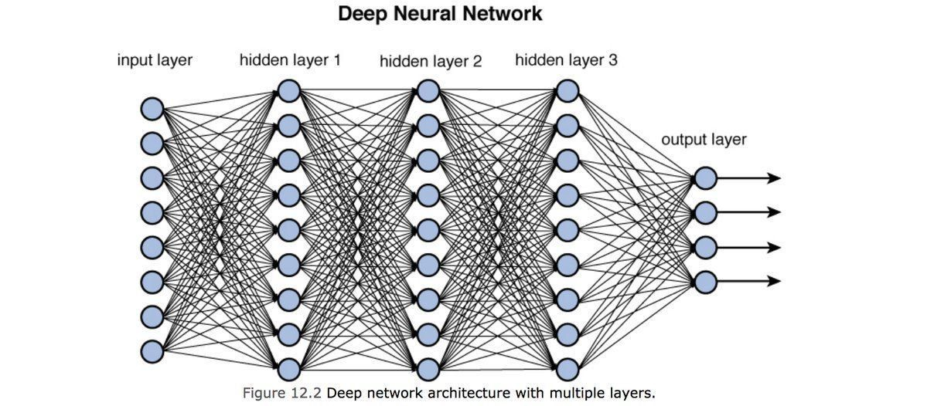
Deep Neural Network (DNN)
Neurons
Neural Network
“Deep” Neural Network
Many(Deep) Layers

Slide 5
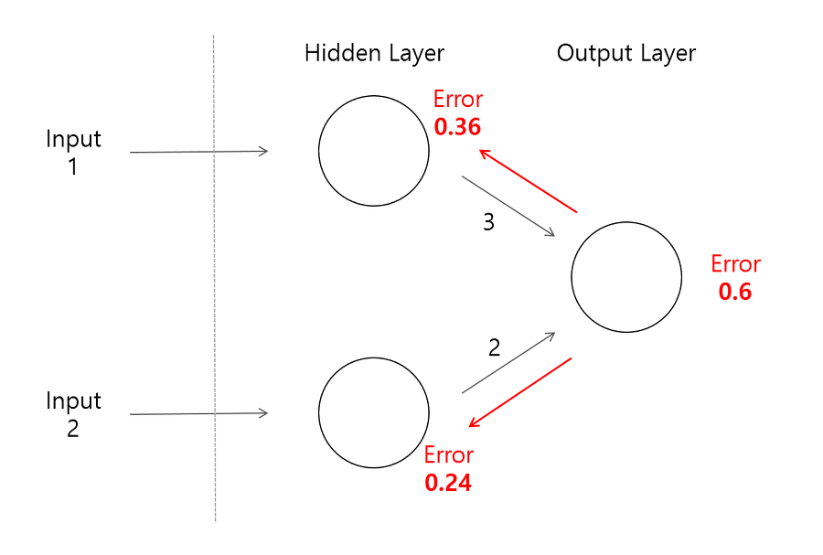
Deep Neural Network (DNN)
Train Data Set(Input Data + Output Data)
“Calculated”
Output
Data
Input
from train data
Adjust weight & bias of layers
Minimize MSE(“Calculated” Output Data, Output from train data)
무조건 layer 개수를 늘릴 수 없는 이유
Error backpropagation이 어려워져 학습 속도 저하 및 에러 발생

Slide 6
Artificial Intelligence
Machine Learning
Supervised
Learning
Unsupervised Learning
Reinforcement
Learning
Classification
Clustering, recommendation
Reward maximization

